Slide 1
Hematology

Slide 2
Cases Studies

Slide 3
Case 1
History
14 year old male.
Presented in emergency clinic with sudden onset of easy bruising, bleeding gums, and epistaxis.
Previously in well health. Mother mentioned he was "never sick before in his entire life."
No history of recent viral infection, and no family history of bleeding disorders

Slide 4
:CBC
RBC 4.52 x 1012/L
HGB 14.4 g/dL
HCT 39.2 %
MCV 82.3 fl
MCH 29.6 pg
MCHC 34.9 g/dL
RDW 14.1
WBC 6.3 x 109/L
Neut. 44 %
Lymph 39
Mono 14
Eosin 1
Baso 2
PLaT <5 x 109/L
MPV 10.9 fL

Slide 5
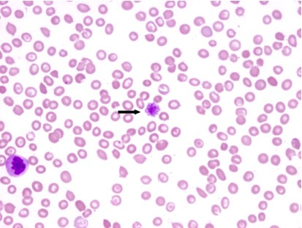
1
Giant platelet is seen

Slide 6
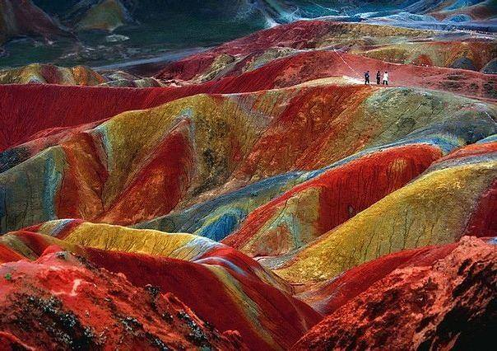

Slide 7
Morphology:
RBC morphology:
Normocytic, normochromic
WBC morphology:
Within normal limits
PLT morphology:
Appear increased in size

Slide 8
Further Laboratory Studies
Bone marrow aspirate:
Erythrocyte and granulocyte maturation within normal limits. Megakaryocytes appear normal in number and morphology.
Slightly hypocellular for his age, with abundant megakaryocytes.
Coagulation:
INR 0.91 PTT 24.8 sec TT 15.8 sec

Slide 9
Diagnosis
Immune thrombocytopenic purpura (ITP)

Slide 10
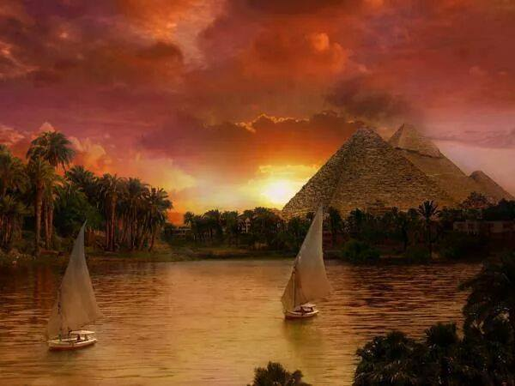

Slide 11
Case Study 2
37 year old female.
History of multiple transfusions , splenectomy two years prior to admission. Reason unclear .
Presented with fever, malaise, epigastric discomfort and nonproductive cough.

Slide 12
C B C:
RBC 4.5 X 101²L
HGB 7.8 g/dL
HCT 28.6 %
MCV 64 fL
MCH 19.5 pg
MCHC 28.2 g/dL
RDW 22.3
WBC 8.0 x 10⁹/L
Neut 55 %
Lymph 34
Mono 7
Eosino 2
Baso 2
NRBC/100 WBC 65
PLaT 500 x 0⁹/L

Slide 13
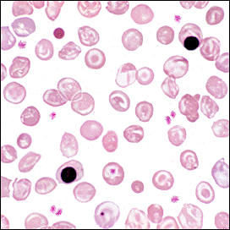
RBCs morphology

Slide 14
History of fibrocystic breast disease.
Physical Exam : Moderate splenomegaly.
No other organomegaly.

Slide 15
Morphologic Alterations
RBC morphology:
Hypochromasia
Polychromasia
Anisocytosis
Trget cells
Howell Jolly bodies present
WBC morphology:
Within normal limits
PLT morphology:
Within normal limits

Slide 16
Hemoglobin electrophoresis:
Hemoglobin E 80 %
Hemoglobin F 5 %
Iron studies:
Serum ferritin 3000 ng/mL
Serum iron 140 µg/dL
TIBC 152 µg/dL
Saturation 92 %

Slide 17



